Slide 1
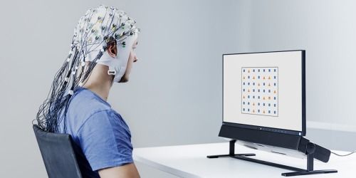

Replicating the thoughts of a coma patient

Slide 2
Presentation Topics
●The Analytics challenge
●Business Problem
●Business Data
●Data Issues & Data Security
●Modeling & Evaluation
●Deploying
●Challenges & Mitigation
●Keeping ahead of Competition
●Learnings & next steps

Slide 3
Analytics Challenge
Healthcare
Importance - Prediction of coma patient’s recovery is an important aspect in healthcare in the present scenario. Because, if a person is healthy, the society will be and so the country.
Impact – Improvising the medication process and digitization of the health sector.

Slide 4
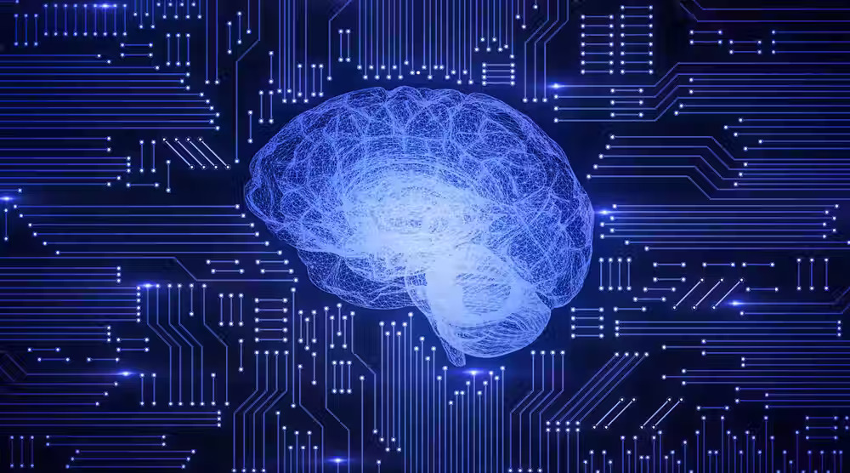
Leaders in this domain
● Arivalagan Masilamani, Sellakumar S are the author where they have done a remarkable job on coma patient monitoring using brain computer interface
● Anusha Ganesan, Malik Junaid Jami Gul- Human-in-the-Loop Predictive Analytics Using Statistical Learning
● Athina Tzovara, Marzia De Lucia- Studying brain responses for various activities
● Stephen J. Mraz- Monitoring brain activity using sensors
● Bill Byrom, Marie McCarthy- Brain Monitoring Devices in Neuroscience Clinical Research
● Philipp Kellmeyer- Big brain data

Slide 5
Business Problem
● Business Problem
Treatment of coma patients is one of the major aspects that the health sector all over the world is working on.
Also, predicting the duration of recovery and the costs included in the treatment is one more problem prevailing today. Analyzing and mirroring the thought of a coma patient on a display screen.
● Importance
The proper treatment of the disease is not available in most of the places globally. So, stabilizing the treatment and digitizing the treatment process, we try to bring in the digitized prediction of the patient’s condition and the probable ways of the treatment thereby.
Since the coma patient will be in the unresponsive stage but the thoughts in the brain will be running as usual. So, we can project the thoughts of the patient to the display with the help of EEG (ElectroEncephalographic Sensor).

Slide 6
Business Problem contd..
●Who are the stakeholders which get impacted by the problem
The main stakeholders of this problem are the persons who are in the coma stage. Also, Doctors, friends, family members, suppliers & vendors will also get impacted.
●The potential benefit of solving the business problem
The recovered patient will be the true potential beneficiary of the problem.

Slide 7
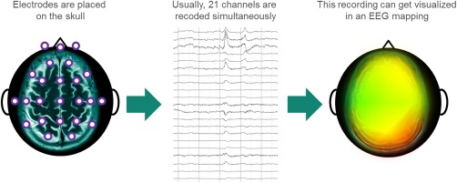
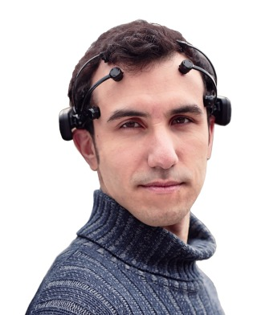
Business Data
●The Data that relates to the problem(s)
The data here is nothing but the brain’s neural signals that can be collected by the device attached over the brain. The collected data will be from normal person, coma patient, & patient cured from coma.
●The source from where you can collect the data
We will gather biological signals from the EEG Sensor and will be recorded. The EEG sensor is attached to a device which interprets the signals and converts to a human recognizable format.
●Challenges to solve while collecting data
The reliability of sensors and actuators.

Slide 8
Business Data Contd..
●How the data that is generated in the signal format be analysed?
Here we will be converting the signal data into the human readable format with the helpm of representing the graphs over the labeled axes.
● How do we comapre the data of the patient with the cured one’s.
With the help of the preferential data of the patient taken from his/her family and friends, etc. We will try some experiments on the patient for looking his/her reactions on it. Like, playing some music, showing some visuals, making his/her loved one’s talk with the patient, etc.
From the above data , we put them into diffeerent mood clusters. Like, happy, sad, inresposive, etc.
Now, we would be comapring the generated data with the data (in similar situations) of the normal and the cured patient. There by we will get to know the patient’s present condition and would be in a position to estimate the recovery rate and also suggest some changes in the medications.

Slide 9
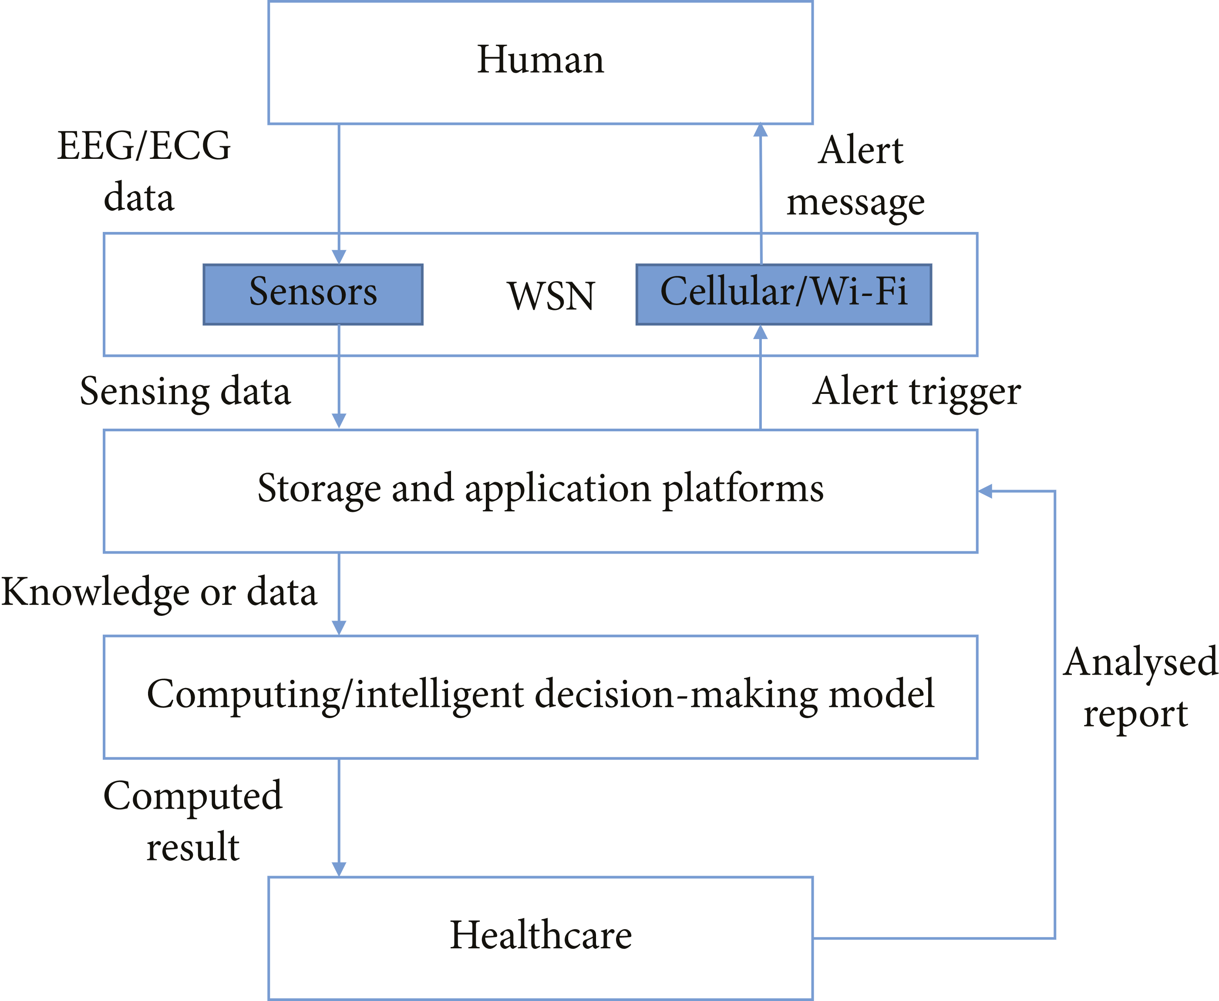

Slide 10
Potential Data Issues including Security
The major issue is the breach of data and utilization of the data in an inappropriate way.
The breached data in the destructive hands may lead to death of a person.
Unwanted signals connected to the main signal which is not required for evaluation can be treated as noise.
The collected data is not private, as it can be viewed by any person connected to the machine over a channel can access the information.

Slide 11
Modeling & Evaluation
●Suggested models used for solving Business Problem(s)
Comparing the data of the cured patient and patient
The EEG sensor data
Supervised learning model and Unsupervised learning
Clustering technique
Decision Tree

Slide 12
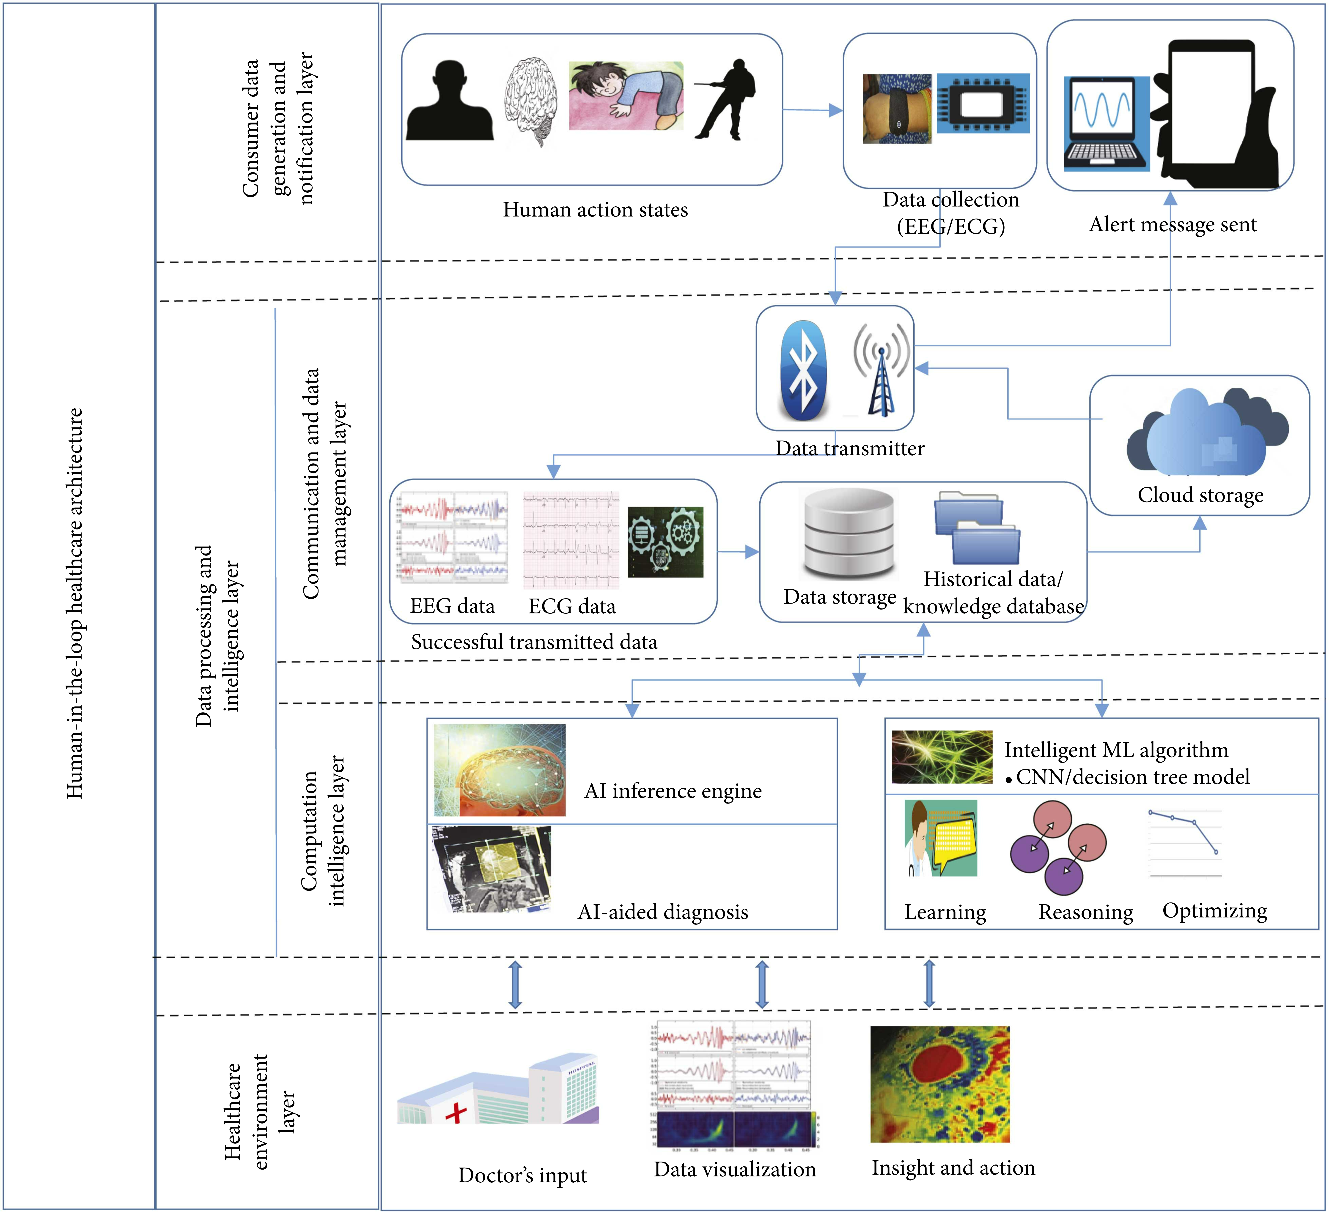

Slide 13
Data from Humans
We get the data from the EEG sensors
Converts the data into the human readable format
The data is stored
We analyse the data with the help of machine learning techniques like, CNN, Decision Tree, Clustering, etc.
We will share the insights to the doctor(s)
The recommendations made by him will be sent to the online platform through storage.
The insights and the recommendations can be viewed by the patient family members and keep the track of the patient’s recovery.

Slide 14
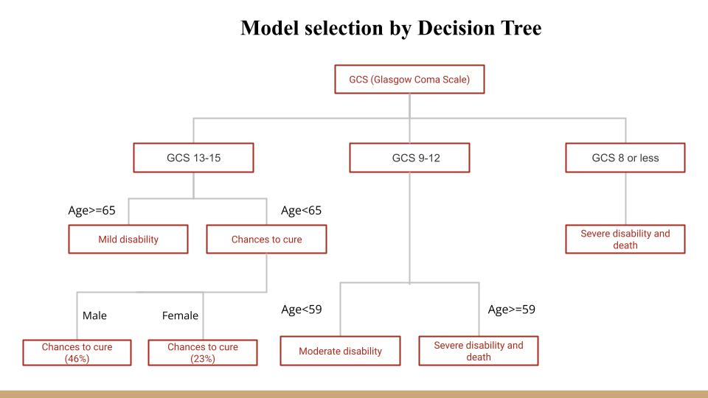

Slide 15
Deployment
The process is energy efficient and the equipment is minimal. We can also monitor the patient's condition and compare the recovery rate. So this can be made available not only in tier 1 cities but also in tier 2 and 3 cities too.
Here, we will test the model which will give us more accurate result of our observation. If there is any discrepancy in the model, will go back to the previous stage and apply different model to get the desired result. Since, cured patient dataset will be available to us by which we can relate to the desired model.
As the concept is to read a person's mind, we can also deploy this in the investigation of crime cases.
We can also use the data and electronic signals and try to control robotic arms with brain signals.

Slide 16
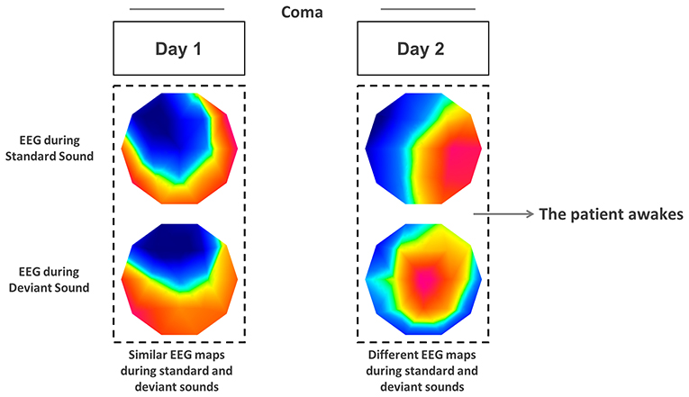

Slide 17
Challenges & Mitigation
Challenges:
The major challenge would be the lack of proper technical expertise in performing the experiment.
The collected data may contain more noise and needs to be sorted and cleaned in order to obtain the required data on which the model needs to be tested.
It will be a tough part to accept the experiment conducted on patients and alive brains (people) by the family and relatives.
Mitigation:
Awareness should be raised in people by running campaigns and explaining the advantages.
Also, specific technical experts are to be brought and work together to get the desired result

Slide 18
Keeping ahead of Competition
Since, everybody wants to get cured in an effective manner. People will go with the digitized treatment for coma.
The data regarding the patient's condition will be made available and can be constantly monitored by using IOT.
Data privacy of patients is also important.

Slide 19

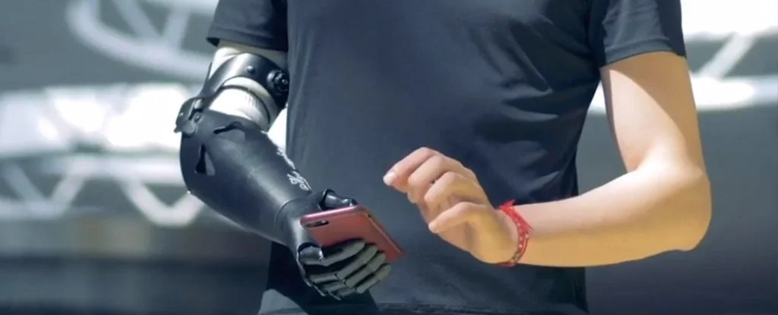
Learnings & future plan
By using the data obtained, we can learn about the improvement in the patient’s condition.
Improvement in the medication for the treatment in tune with the patient’s recovery status.
The future plan includes the usage of the data in
crime investigation and
robotic arm control.

Slide 20
References
https://www.researchgate.net/publication/342833749_COMA_PATIENT_MONITORING_USING_BRAIN_COMPUTER_INTERFACE
https://www.hindawi.com/journals/jhe/2021/9955635/
https://kids.frontiersin.org/articles/10.3389/frym.2019.00019
https://www.machinedesign.com/motors-drives/article/21837605/sensor-monitors-more-brain-neurons
https://www.ncbi.nlm.nih.gov/pmc/articles/PMC6032823/
https://link.springer.com/article/10.1007/s12152-018-9371-x

Slide 21



